Slide 1

New guests from germany without touching your marketing-budget
How you can profit from barter-cooperations with the „Süddeutsche Zeitung“
Notes:
Dir ist bewusst, dass eine kantige, klare Positionierung wichtig für deinen Unternehmenserfolg ist.
In der Theorie ist das alles klar, in der Praxis fällt es dir schon schwerer, eine wettbewerbsfähige Wettbewerbspositionierung zu erbeiten.
Deshalb widmen wir uns heute gemeinsam diesem Thema.

Slide 2
Barter Cooperation „Süddeutsche Zeitung“
Süddeutsche Zeitung:
Print-ad
Hotel/supplier :
Equivalent amount of package or value
Notes:
Worum geht es wirklich? <mudd

Slide 3
STEP 1: TRAVEL-Auction„KAUFDOWN“
Süddeutsche Zeitung offers an own online-platform for travel-auctions with daily hotel-offers per auction.
You provide „travel vouchers“ for certain values, which are auctioned.
Customers pay to „Süddeutsche Zeitung“. You receive the ad in the value of the equivalent amount provided by you, not depending on the sales-value.
This business-model is no dumping-sale but a marketing-event. The customers who were the best-bidders for your travel-vouchers finance your ad(s).
Redemption of the travel vouchers can be limited by you to specific seasons and upon availability. Every customer receives a certifcate of purchase by Süddeutsche Zeitung and has to call for a reservation.

Slide 4
STEP 2: Your AD(S)
Various formats and special theme supplements
Süddeutsche Zeitung is the leading quality media in (South) Germany.
Range:
  Regular paper and most theme-supplements: 640.000 quality-readers.
  Travel section: every Thursday, 1,27 Mio. quality-readers
Online-offers also available but not for barter. Ask us for more info.

Slide 5
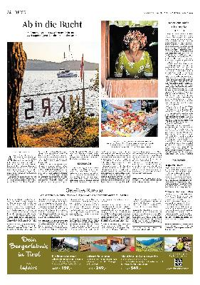

EXAMPLE 1:
Travel section:
  every thursday
  1,27 Mio. readers
See example left:
  371 x 80 mm
  Barter-value: EUR 3.900,-- (2022)

Slide 6
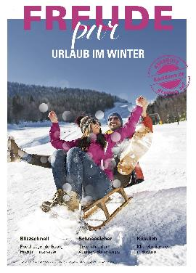
Example 2
Theme-supplement „Freude pur“
Approx. 10 theme-supplements per year (Wellness, mountain-holidays, summer, winter, etc.) –see the details in the link (german only):
  https://www.misterblue.at/sueddeutsche-zeitung-spezial
Excellent Journalism and high-class-theme-supplement
Range: approx. 640.000 readers
  Barter-value: 1 full page EUR 5.900,--
  half page EUR 3.200,-- ( 2022)

Slide 7
Why MR. BlUE & friends:
Partner agency of Süddeutschen Zeitung with best connections
Experience and Know How for how to use „travel-auctions successful in your marketing-strategy.
Consulting, arranging and guiding you through.
In case of need we translate your text from english to german

Slide 8
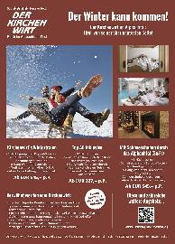
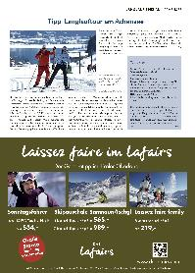
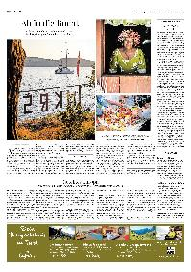
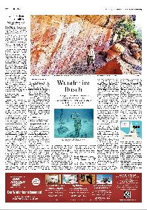
Do it as many TOP-Hotels in Central europE DO
Far more than 100 leading hotels from different countries regularly participate on the travel auctions of Süddeutsche Zeitung
References and examples on request

Slide 9
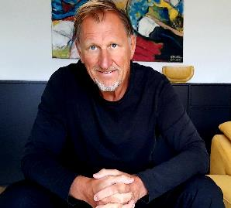
Contact:
Also see: https://www.misterblue.at/auktionen
Simply contact me:
Gerald Grossbauer (aka Mr. Blue)
+43 676 431 62 32
info@misterblue.at

